Slide 1


Use of TEMPO data for Extreme Events and Disasters in the Western U.S.
Mary Uhl, WESTAR
Joint Science Meeting for TEMPO, GeoXO ACX and TOLNet
May 4, 2023

Slide 2
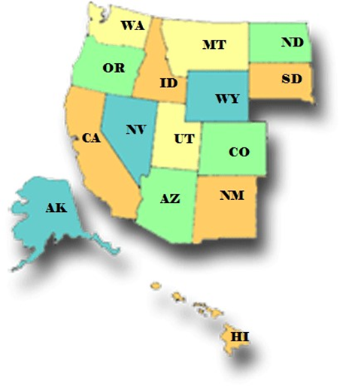


The WESTAR Region
15 Western States
24% of US population (2020 US Census)
50% of US landmass
573,284,316 acres of federally-owned lands➔93% of total federal lands in the US

Slide 3
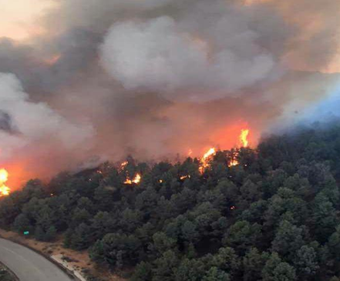
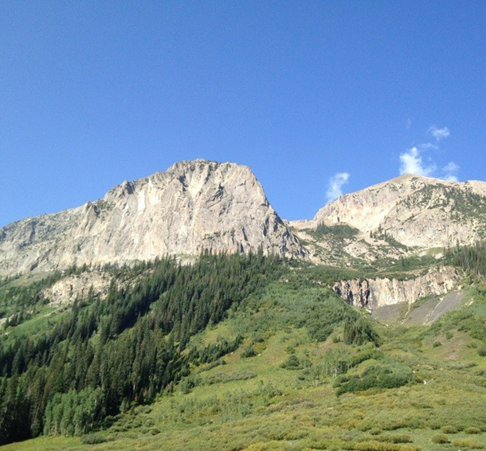
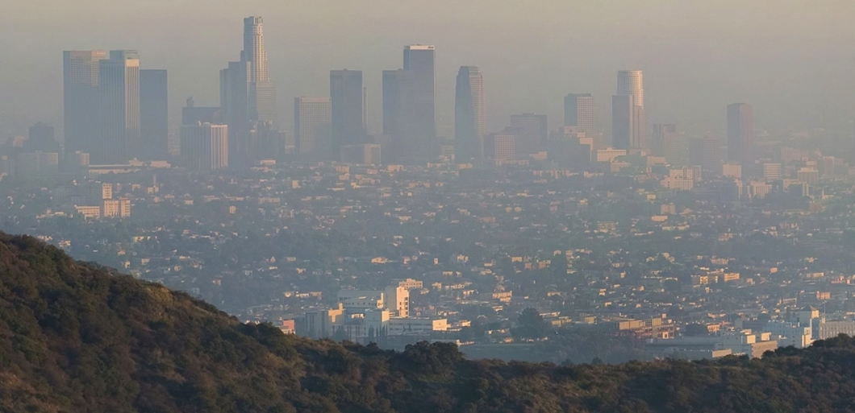

The West is different:
Dominant role of wildfire smoke
Meteorology (mountain-valley, photochemistry on snow surfaces)
Terrain
“the complex terrain, variety of emissions, meteorology and spatial vastness suggests that Western U.S. assessment practice will lead efforts in comprehensive air quality characterization out of necessity”

Slide 4

TEMPO data can assist the West
Wildfire smoke exceptional event analysis
International Transport of Pollutants
Dust storms and aridification in the west
Poor Characterization of Emissions

Slide 5
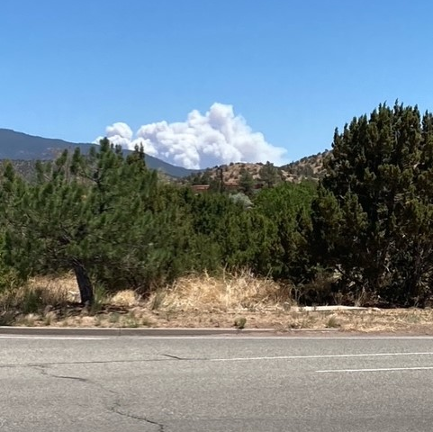
WESTAR Mary Uhl maryuhl@westar.org

